Slide 1
Robotics
05
Denavit Hartenberg
TEKNIK
TEKNIK ELEKTRO
Zendi Iklima ST, SKom, MSc

Slide 2

Denavit-Hartenberg Convention
In 1955, the key concepts of kinematic for serial-link manipulator introduced by Jacques Denavit and Richard Hartenberg. A coordinates system attached between the links of manipulator, follows:
The joint $i+1$ intersected with the origin coordinate system $i$ between axis joint $i$ and $i+1$.
The $x_{i}$ axis is aligned by the common normal of joint link axis $i$ and $i+1$ and the point itself.
The $y_{i}$ axis is determined by use of the right-hand rule.
The $z_{i}$ axis is aligned with the axis of the joint $i+1$. The positive direction can be chosen arbitrarily.

Slide 3
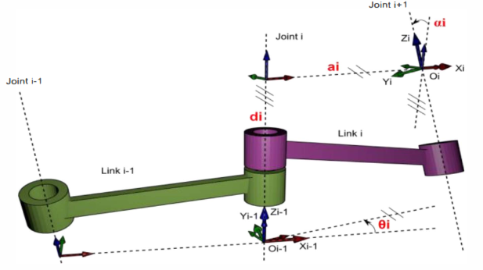
Denavit-Hartenberg Parameters

Slide 4

Denavit-Hartenberg Parameters
The Denavit Hartenberg (DH) associated with a particular convention for attaching reference frames to the spatial kinematic chain link, which consists of ^{[14, 15, 28, 54, 58, 59, 62]}:
Join offset ($d_{i}$): Offset distance among the common normal of the axis of $join i−1$ to $join i$ and the common normal of the axis of $join i$ to $join i$+1 ($X_{i−1} to X_{i} over Z_{i} and X_{i} to X_{i+1} over Z_{i+1}$).
Join angle ($θ_{i}$): An angle measured among the common normal of the axis of $join i−1$ to $join i$ and the common normal of the axis of $join i$ to $join i$+1 ($X_{i−1} to X_{i} over Z_{i} and X_{i} to X_{i+1} over Z_{i+1}$).
Link length ($a_{i}$): The length of the link is common normal length between the axis of $join i−1$ and $join i$ ($Z_{i−1} to Z_{i} over X_{i}$).
Twist angle ($α_{i}$): Twist of the link is an angle measured between the axis of $join i−1$ and $join i$ ($Z_{i−1} to Z_{i} over X_{i}$).

Slide 5



Homogeneous Transformation Matrices
Transformation matrices established through 2 successive are rotations and translations of the ${(i−1)}^{th}$ coordinate system explained below ^{[54, 56, 59]}:
Distance $d_{i}$ translated the ${(i−1)}^{th}$ coordinate system along $Z_{i−1}$ axis is:
Angle $θ_{i}$ rotated displaced coordinate system about $Z_{i−1}$ axis, the displaced $X_{i−1}$ axis aligned with $X_{i}$ axis is:

Slide 6



Homogeneous Transformation Matrices
Distance $a_{i}$ translated displaced coordinate system along $X_{i−1}$ axis is:
Angle $α_{i}$ rotated displaced coordinate system about $X_{i−1}$ axis, the displaced $Z_{i−1}$ axis aligned with $Z_{i}$ axis is:

Slide 7
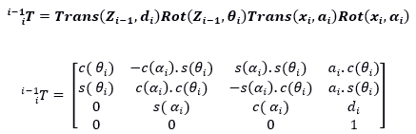
Homogeneous Transformation Matrices
Transformation matrix result is ^{[15, 54, 56, 58]}:

Slide 8
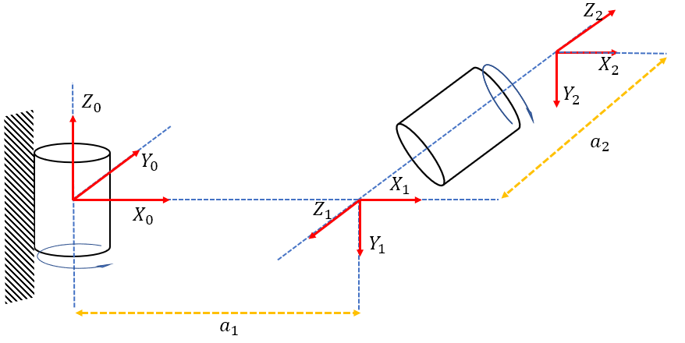
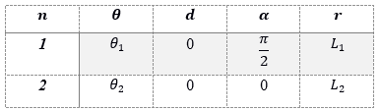

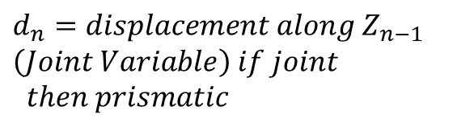
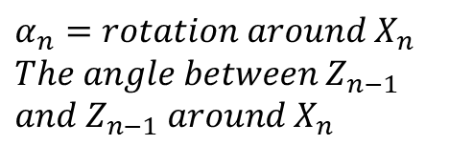
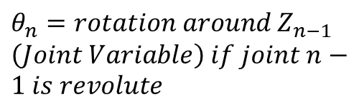
Example in 2DoF Robot
$θ_{n}=rotation around Z_{n−1}$
$\left(Joint Variable\right) if joint n−1 is revolute$
$$r_{n}=displacement along X_{n}$$
$α_{n}=rotation around X_{n}$
$The angle between{ Z}_{n−1}$
$and{ Z}_{n−1} around X_{n}$
$d_{n}=displacement along Z_{n−1}$
$\left(Joint Variable\right) if joint$
$then prismatic$

Slide 9


Example in 2DoF Robot

Slide 10

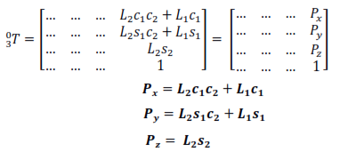
Example in 2DoF Robot (FK)

Slide 11
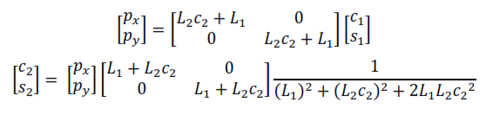
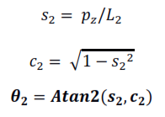
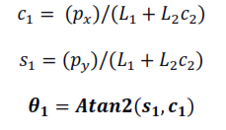
Example in 2DoF Robot

Slide 12
Example in 2DoF Robot

Slide 13
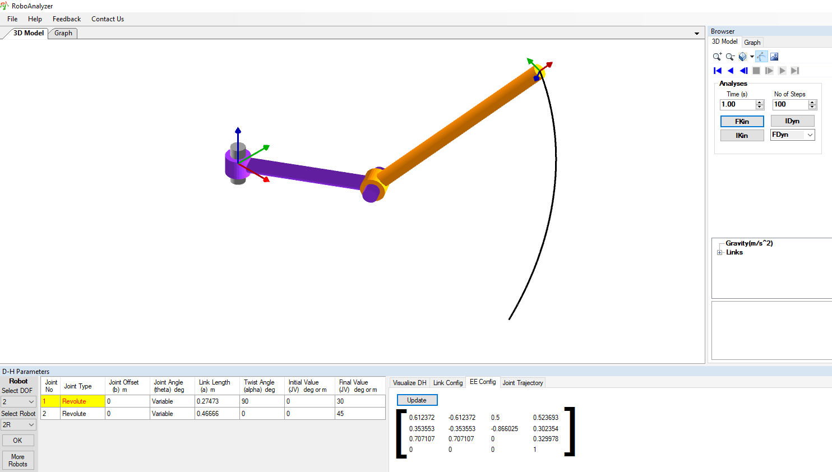
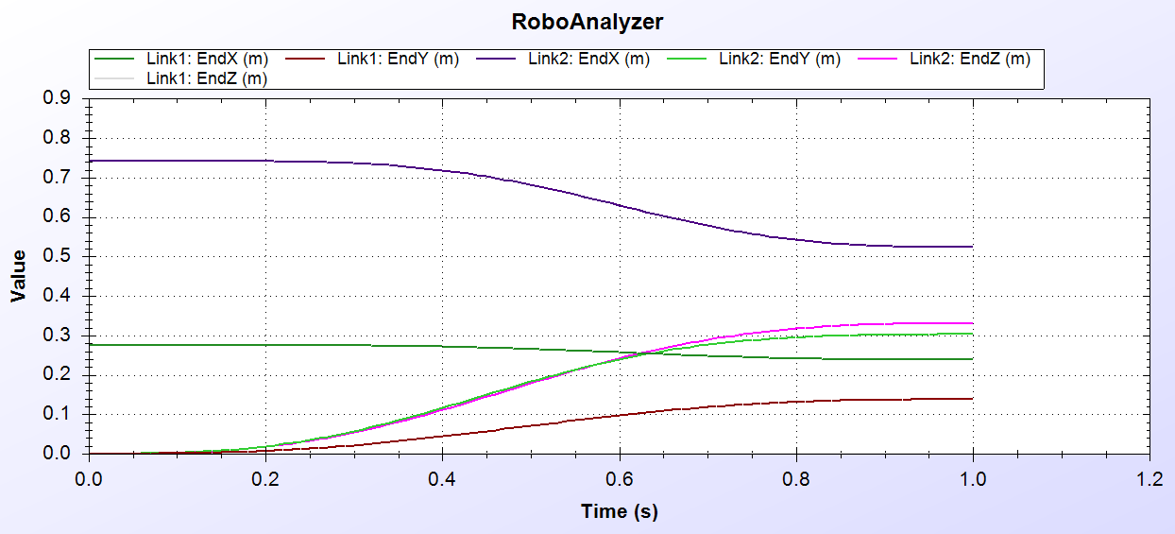
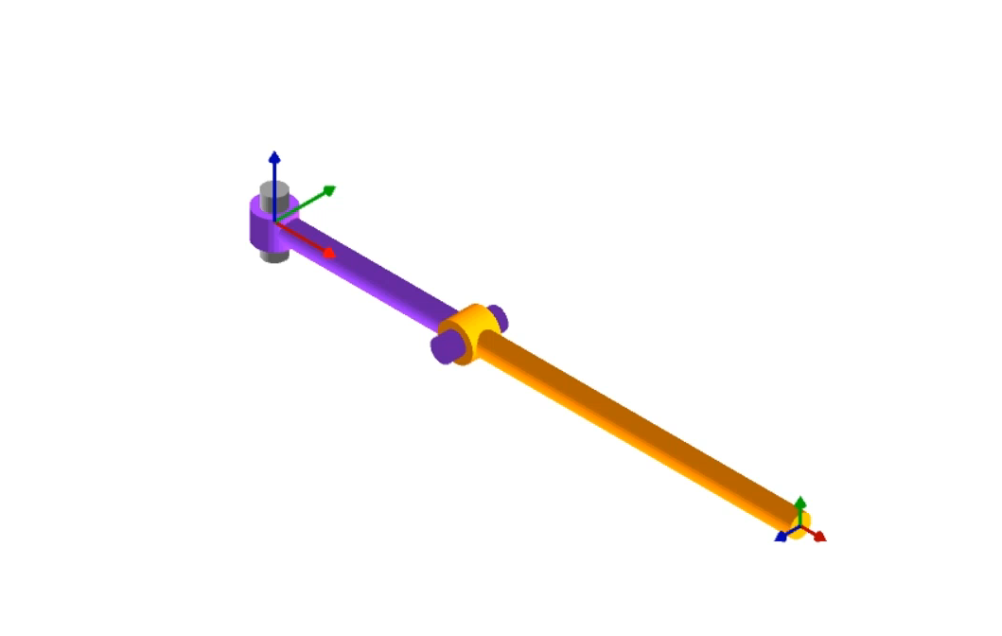
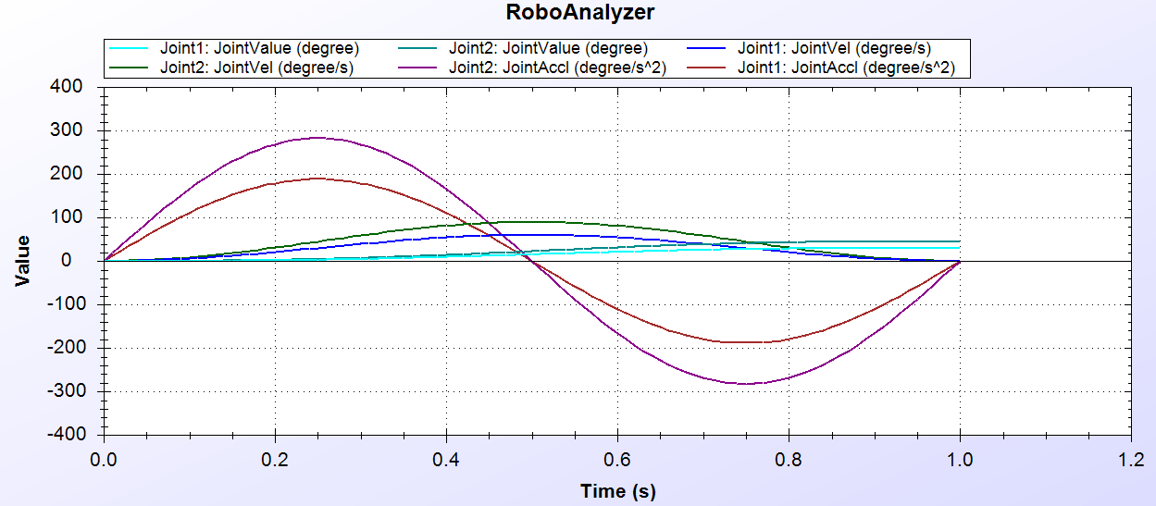
Example in 3DoF Robot
http://www.roboanalyzer.com/downloads.html

Slide 14





Code Editors

Slide 15
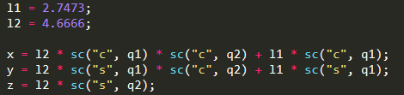
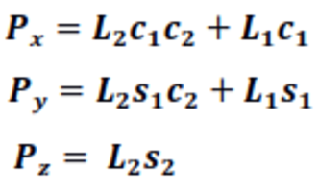
Example in 2DoF Robot

Slide 16
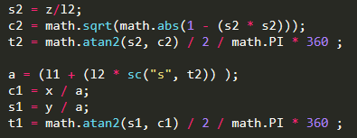
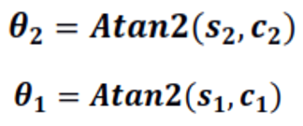
Example in 2DoF Robot

Slide 17
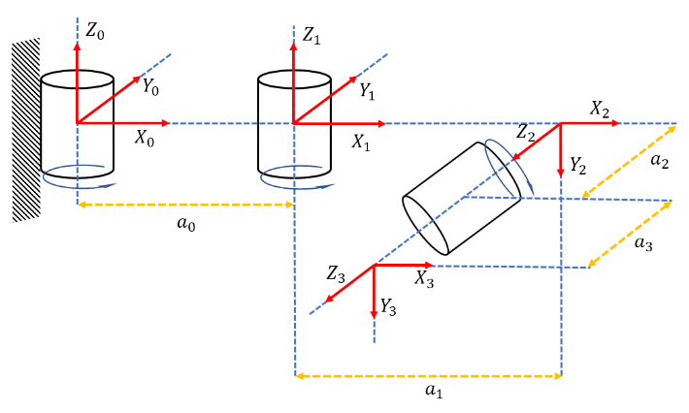
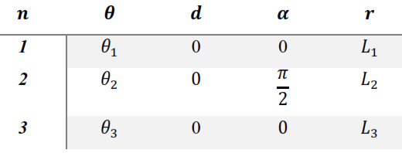
Example in 3DoF Robot

Slide 18
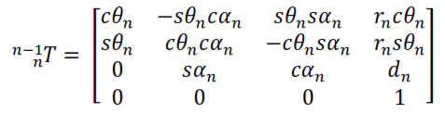
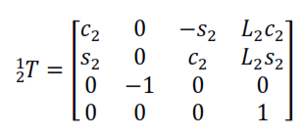
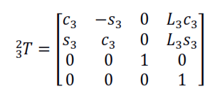
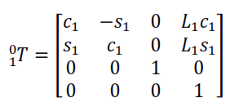
Example in 3DoF Robot

Slide 19

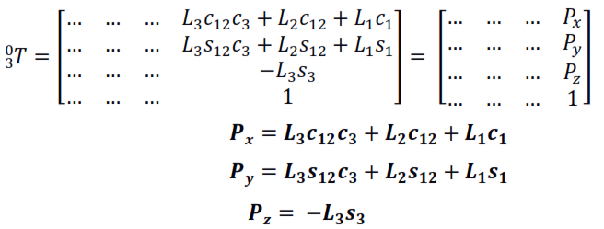
Example in 3DoF Robot

Slide 20
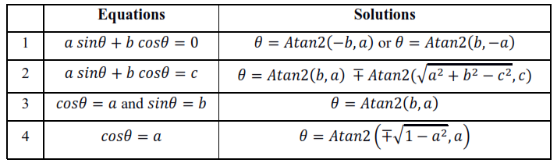
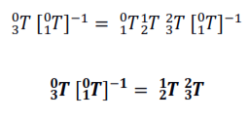
Simplification

Slide 21
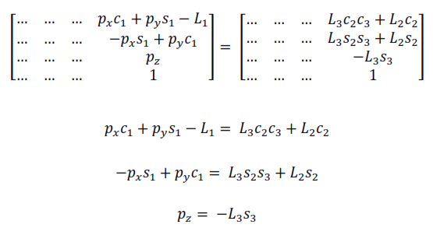
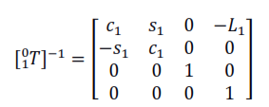
Example in 3DoF Robot

Slide 22
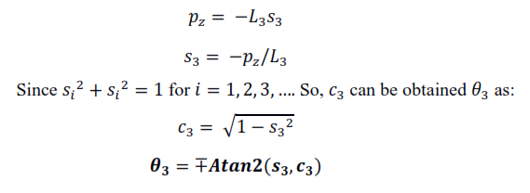
Example in 3DoF Robot

Slide 23


Example in 3DoF Robot

Slide 24
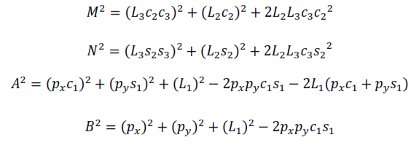


Example in 3DoF Robot

Slide 25
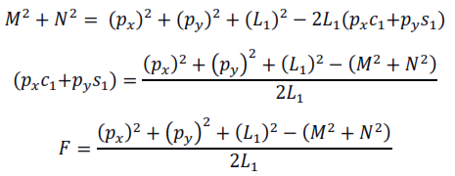


Example in 3DoF Robot

Slide 26
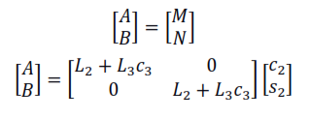

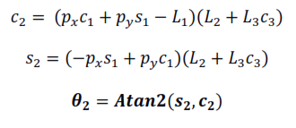
Example in 3DoF Robot

Slide 27
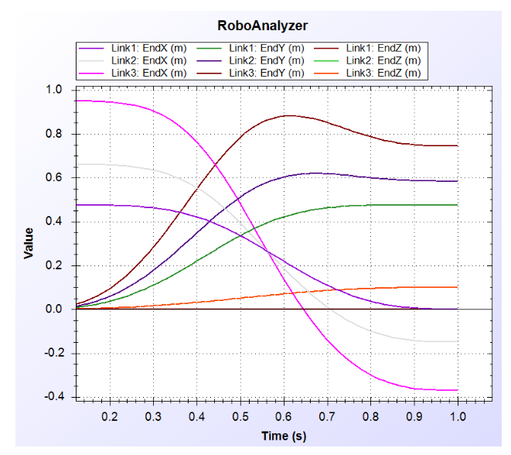
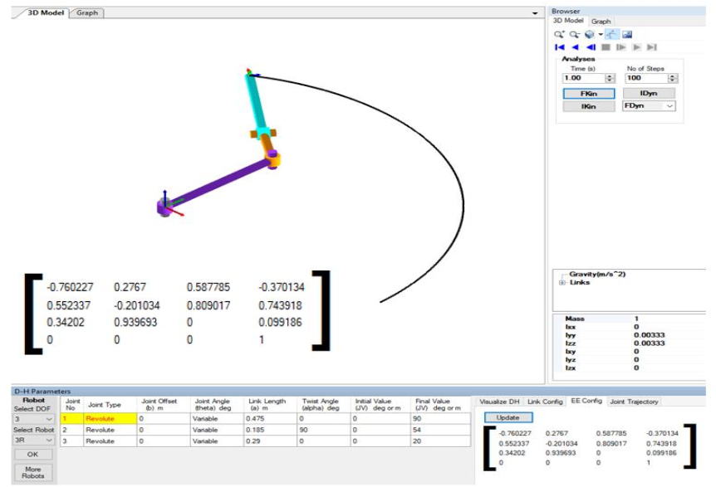
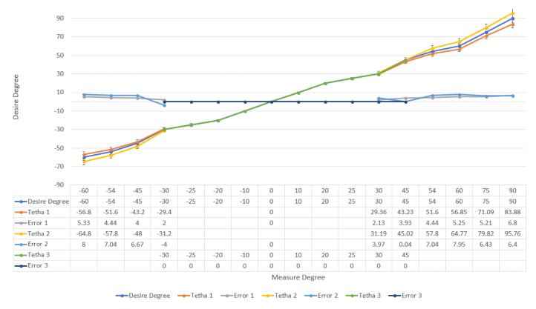
Example in 3DoF Robot
http://www.roboanalyzer.com/downloads.html

Slide 28
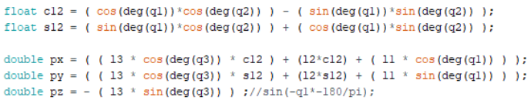
Example in 3DoF Robot

Slide 29
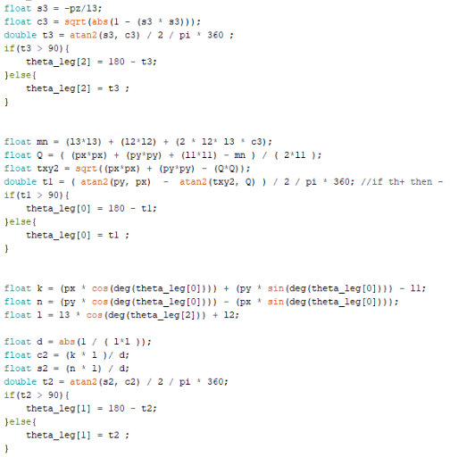
Example in 3DoF Robot

Slide 30
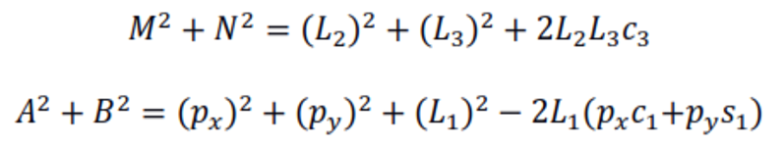
Example in 3DoF Robot

Slide 31
Example in 3DoF Robot

Slide 32
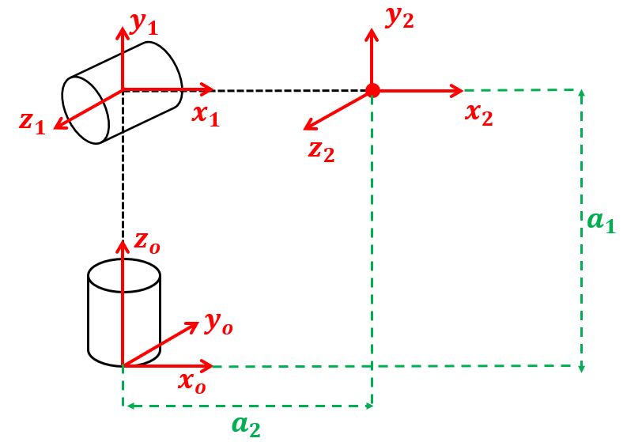
Exercise
Map the DH Parameters!
How the Forward Kinematic Looks Like?
How the Inverse Kinematic Looks Like?
Simulate it!

Slide 33











Exercise
$$y_{1}$$
$$y_{2}$$
$$z_{1}$$
$$x_{1}$$
$$x_{2}$$
$$z_{2}$$
$$a_{1}$$
$$z_{o}$$
$$y_{o}$$
$$x_{o}$$
$$a_{2}$$

Slide 34
Zendi Iklima ST, SKom, MSc

